Slide 1
Blackboard2.0

Slide 2
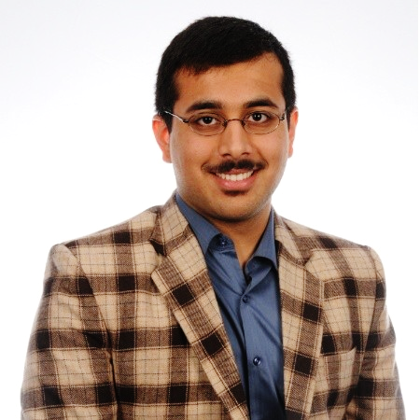
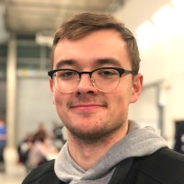
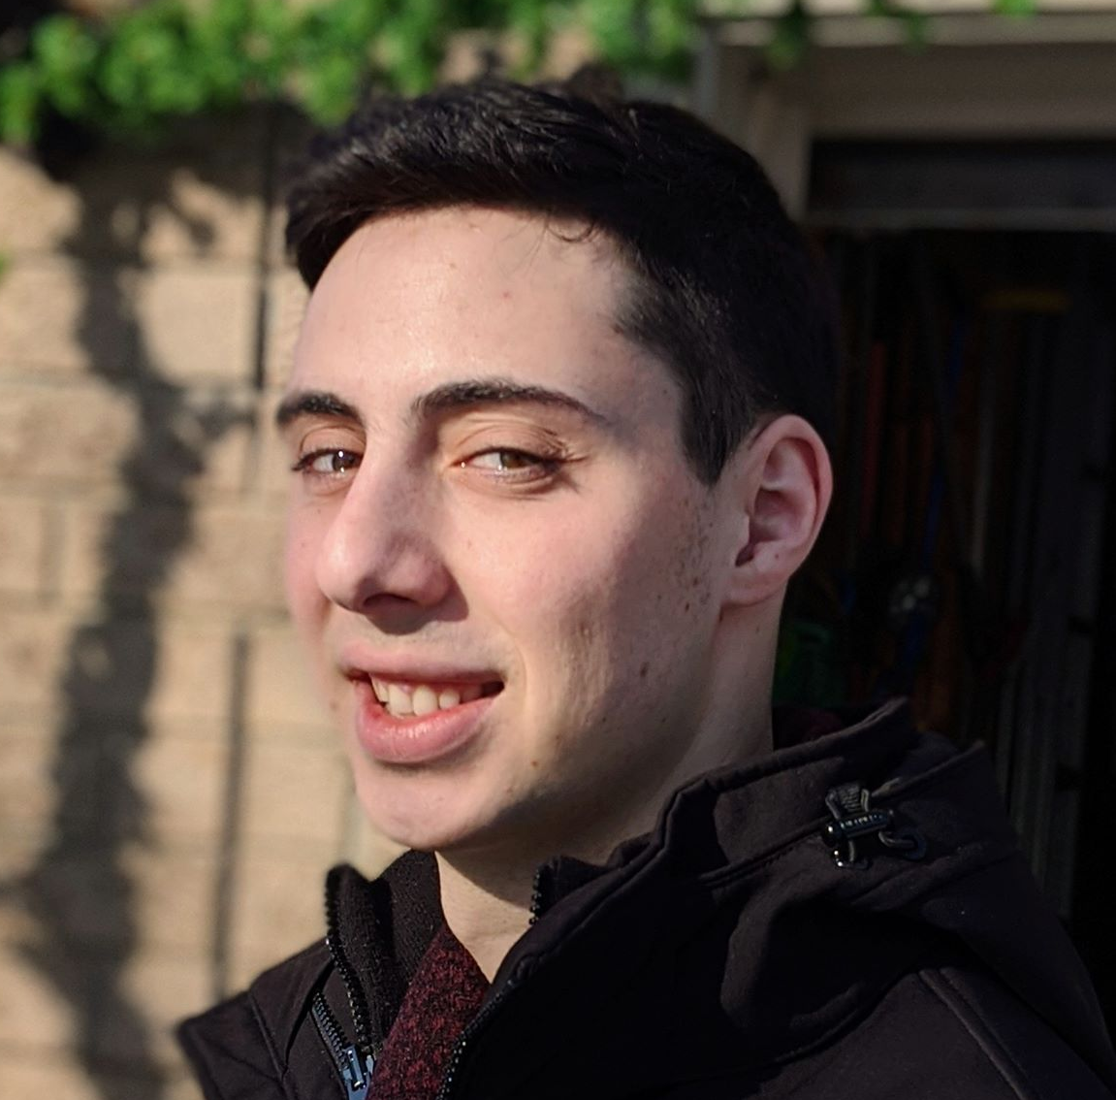
Our Team
Aryan
Systems Developer
Database Admin
Emil
Process Analyst
Quality Assurance Analyst
Designer
Jamieson
Engineer
Team Lead
DevOps

Slide 3
Introduction
1
Let’s start with our description and problem statement

Slide 4
Proposal Timeline
Outline Project Objectives
Define Measures of Success
Estimate Project Duration with Activity Diagram
Perform Risk Analysis and note Countermeasures
Notes:
aryan

Slide 5
Project Goals
Develop centralized platform where students & alumni get updates about courses & events
Helps management measure performance of school
Develop Mobile and Web Applications Simultaneously
Notes:
aryan

Slide 6
Objectives
Measures of Success
Application will be modularized based on user groups (student, management & alumni)
Use Banner for authenticating all user groups.
Web and Mobile platforms will use similar tech stack
Program has Messaging System for communication between all users
Management has extra powers:
Add/drop classes
Track discussions & messaging for harassment
Separate modules for each user group, with its own features (moving users between groups is also possible)
Program redirects to Banner for logging in users
Simplified maintenance due to similar tech and tools used by program
Intra- and Inter-group communication is successful (and chat-room creation is enabled)
Program informs management of harassment and cyber-violence
Management is able to add/drop and edit classes

Slide 7


Technology Stack
Frontend
React and React Native
Can use same framework for mobile and web
Server
Go-Lang for HTTP Server with in-built concurrency
Will work as an API with RESTful API endpoints or GraphQL
NGINX for reverse proxy
Database
Relational and user-permission managed
Will handle events such as updates, harassment tracking, ...
Deployment & Production
Amazon Web Services for hardware management
Combine with Docker for CI deployment pipeline
Security
Handled by the university
SSL Encryption with Bearer-Token access
Testing
Continuous Integration with TravisCI
UAT Testing for mobile and web separately
Notes:
Jamieson

Slide 8
Project Estimation
COCOMO
Will follow Semi-Detached system model
E = a (KLOC)^{b}
= 3.0 (15)^{1.12}
= 62.28 person-months
Albrecht Complexity Multipliers
Used to estimate total function points
External User Types | Estimate | Complexity | Total
EI | 6 | 4 (Medium) | 24
EO | 10 | 5 (Medium) | 50
EQ | 4 | 3 (Low) | 12
LIF | 4 | 10 (Medium) | 40
EIF | 2 | 10 (High) | 20
Total Function Points (FP) |  |  | 146
Notes:
Emil

Slide 9
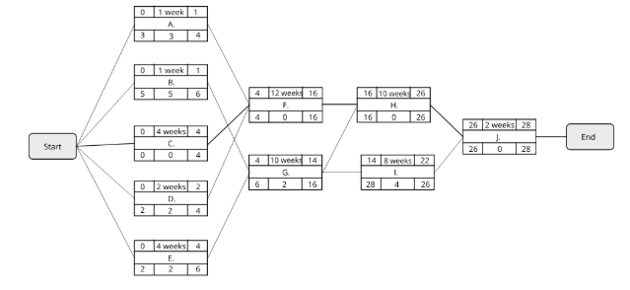
Activity Diagram
A: Development Server Setup (1 wk)
B: Mobile Env Setup (1wk)
C: Data collection (4wks)
D: Create software architecture for server (2wks)
E: Design UI/UX (3wks)
F: Server Development (6 sprints, 12wks)
G: Mobile application Development (5 sprints, 10wks)
H: Quality Assurance (5 sprints, 10wks)
I: User Acceptance Testing (2 sprints, 2wks)
J: Set up production server and deployment (1 sprint 2wk)
Notes:
Emil

Slide 10
Risk Analysis
Tech Setup Complications
Initial setup may be hard to modify in later stages
Solution: Conduct extensive prior research
Vague Requirements
Requirements spec. page is too broad
Solution: Follow Agile and connect with client after every increment
Inconsistent Data
Test data from client can have faults.
Solution: Spend time cleaning and pre-processing data
Unclear Client Design
Requirements can be misinterpreted
Solution: Use SQA group to interface with client
Missing Sprint Deadline
Increment deadlines missed in Agile process can delay final product
Solution: Reduce increment size; under-estimate expectations
Notes:
aryan

Slide 11
Gantt Chart

Slide 12
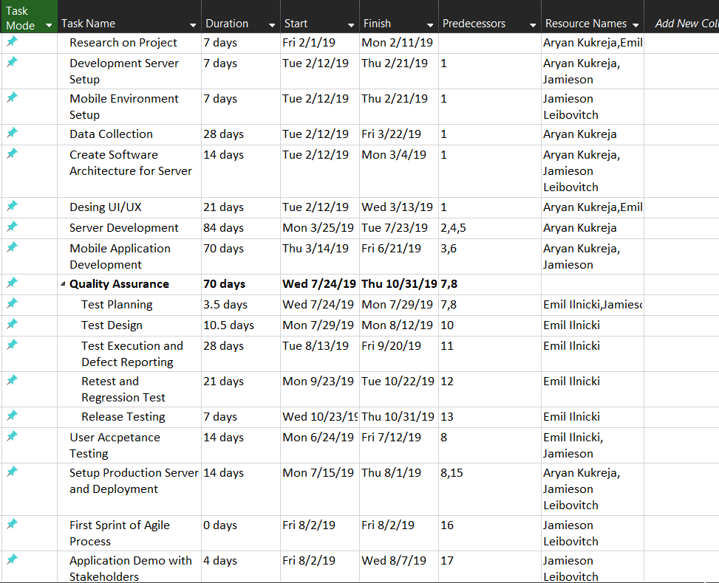
Notes:
Emil

Slide 13
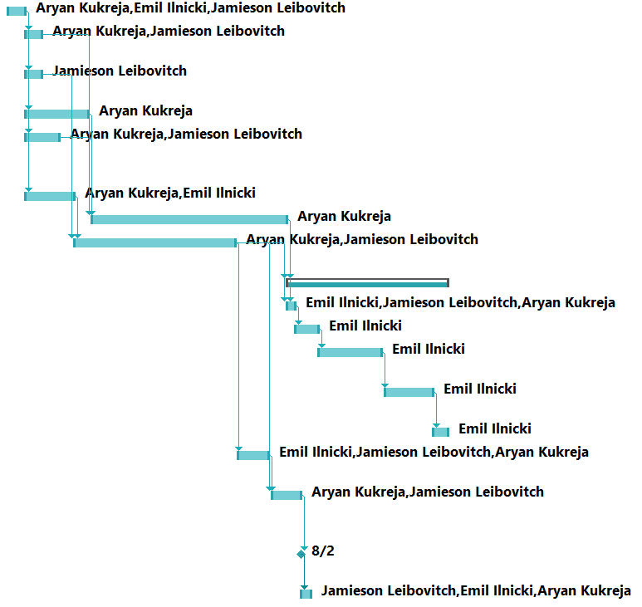
Notes:
Emil

Slide 14
THANKS!
Any questions?

